Slide 1




HTML INJECTION
TEAM
DESIGN AND DEVELOPMENT OF SECURE SOFTWARE
MEMBERS:
JUAN BRAYAN TORREZ MUÑOZ
JOSE DE JESUS TORRES ESPARZA

Slide 2

WHAT IS HTML INJECTION?
HTML Injection is a type of attack that occurs when an attacker exploits vulnerabilities in a web application to inject malicious HTML code into the page. This can allow the attacker to steal sensitive information, perform unauthorized actions, or take control of the application.

Slide 3
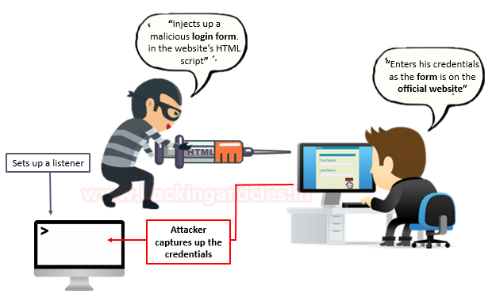

Slide 4
ACTIVITY

Slide 5

INSTRUCTIONS
Enter the next link https://github.com/Confley/HTML_Injection
Download the branch (.zip) of the project.
Place the practice folder inside your local server. For example, in MY CASE the path would be: C:\xampp\htdocs\injection.
Create a new database called injection_bd.
Import the comments.sql file into the database you just created.
Access the index.php file on your local server. For example, in MY CASE it would be: http://localhost/injection/practica/index.php.
Now you can start practicing and exploring the vulnerabilities of HTML Injection!

Slide 6

CODE TO INJECT
1.- <input class="form-control" placeholder="Filtrar" style="position: absolute; top: 275px; right: 120px; width: 300px"/>
2.- <button class="btn btn-danger" onclick="window.location.href=(dirección_malvada);" style="position: absolute; top: 275px; right: 45px"> Filtrar </button>

Slide 7
HOW TO SOLVE
Checking every input if it contains special script or HTML brackets. <script></script>, <html></html>.
Limit the amount of characters that can be saved in a table's column.
Encode the “<“ and “>” to their HTML equivelant.
html = html.replace(/</g, "&lt;").replace(/>/g, "&gt;");

Slide 8

REFERENCES
https://www.softwaretestinghelp.com/html-injection-tutorial/
https://www.devstringx.com/html-injection
https://stackoverflow.com/questions/20855482/preventing-html-and-script-injections-in-javascript

